Slide 1



NextGen Influenza vaccines - Kenya
Team: Naomi R Waterlow, Sreejith Radhakrishnan, Rosalind M Eggo, Mark Jit
R2R

Slide 2
Overview
Potential benefits of next generation vaccines: longer duration, greater efficacy/breadth of protection, potential use as pre-pandemic vaccines, potential use in countries with multiple epidemics a year.
Estimate the incremental health and economic impact of next generation vaccines in seasonal and pandemic situations in key countries, compared to current vaccines.
Use these results to estimate the potential market size for these vaccines under different price points.
These estimates can then be used to inform potential R&D investments by research funders and manufacturers, as well as the return on investment on vaccines for both producers and countries.

Slide 3
Next Generation Flu Vaccines: WHO PPC
 | Improved influenza vaccines | Universal influenza A vaccines
Projected year of licensure | 2022 | 2027
Target population | Children 6-59 months old | All clinical risk groups including children 6-59 months old
Duration of protection | At least one year/influenza season (equal or better than current vaccines) | At least 5 years
Clinical efficacy | Better than current vaccines for either vaccine-matched or drifted strains | Better than current vaccines for vaccine-matched AND drifted strains

Slide 4
Modelling Overview

Slide 5
Dawa et al. (2020) - influenza in Kenya
Epidemics fit with fluevidencesynthesis R package
SEEIIR epidemic model, with vaccination.
Parameters estimated: transmissibility, age-specific susceptibility, age-specific ascertainment rates, initial number of infections

Slide 6
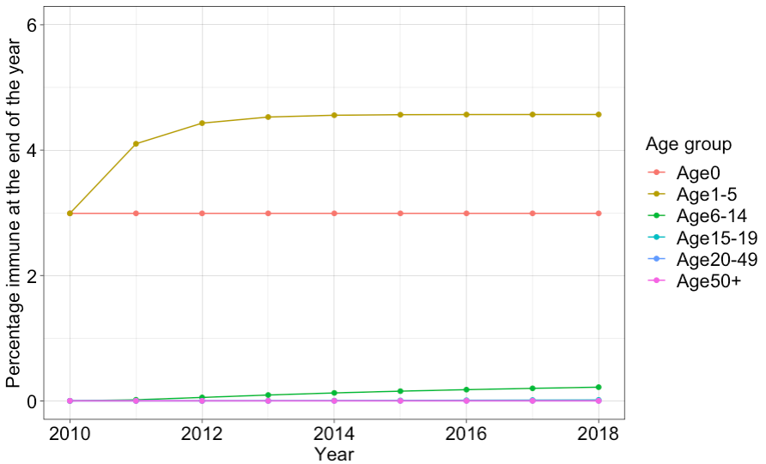
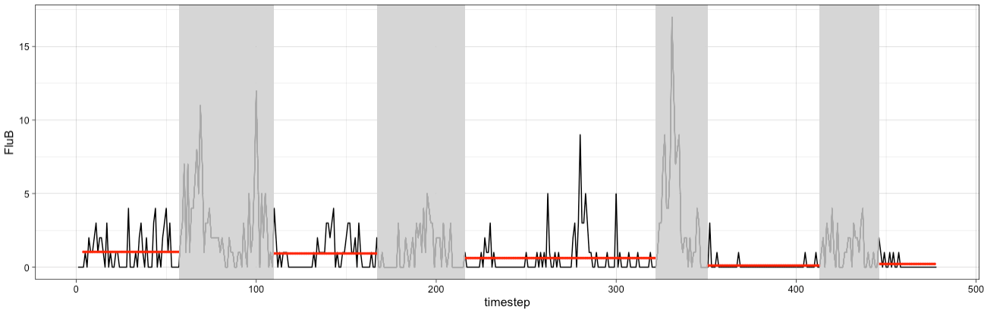
Major differences
Allow vaccination to persist for more than one season, with waning and ageing of vaccinated individuals.
Include a background Force of Infection for “off-season”, by fitting a Poisson to the cases. This can then be reduced dependent on the Vaccination model.
Notes:
This is a suggested plan -> let us know if you have other ideas regarding the vaccination model

Slide 7
Main vaccine scenarios of interest
No vaccine (scenario 1)
Current vaccines (scenario 4 –, 70/40 efficacy, 6months waning)
Improved vaccines broadness (scenario 75 – 70 efficacy, 3 years)
Improved vaccines efficacy (scenario 77 – 90/70 efficacy, 3 years)
Universal vaccines (scenario 122 – 90 efficacy, 5 years)
Sensitivity analysis:
75% coverage in target age groups, instead of 50%
all-year round vaccination, as opposed to campaigns
infection-derived immunity modelling

Slide 8
Combined output over time
Improved
Improved

Slide 9
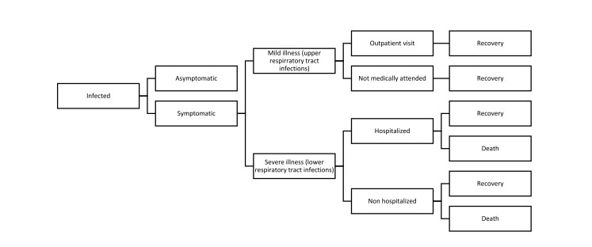
Economic evaluation decision tree
Dawa et al. (2020)

Slide 10
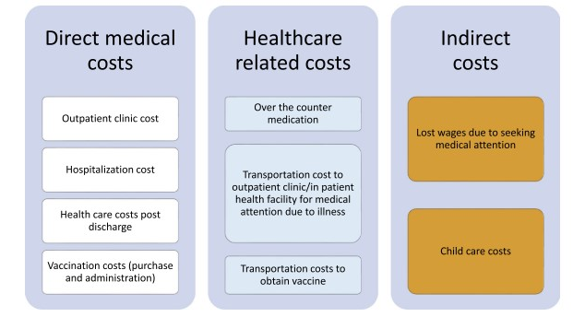
Costs included
Dawa et al. (2020)

Slide 11
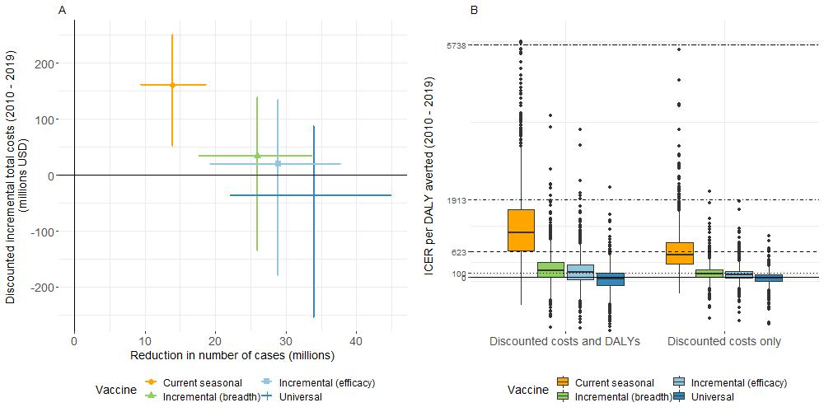
Total doses and ICER per DALY averted
Improved
Improved
Improved
Improved

Slide 12
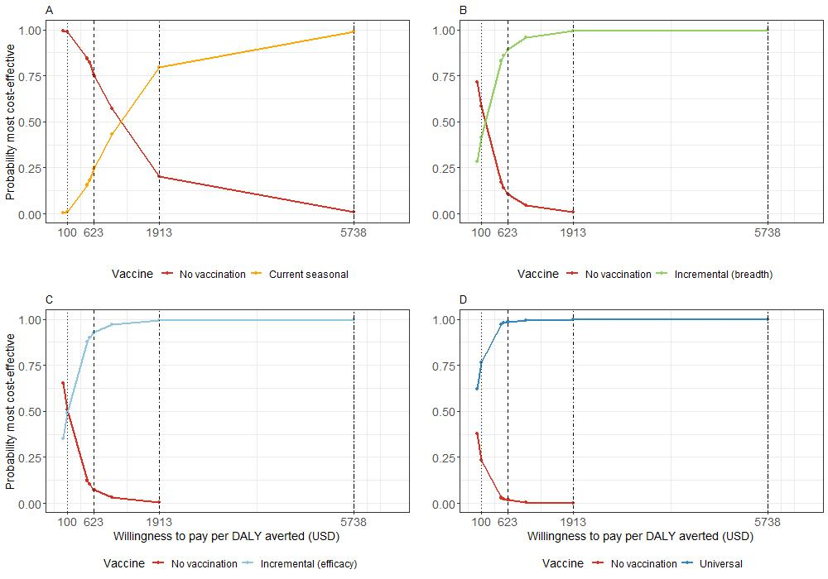
Incremental net monetary benefits, CEAC
Improved (breadth)
Improved (efficacy)
Improved (breadth)
Improved (efficacy)

Slide 13
Threshold per-dose vaccine price (2019 USD)
Vaccine | WHO best buy ($100) | 45% per capita GDP ($623) | 1x per capita GDP ($1913) | 3x per capita GDP ($5738)
Current seasonal | -1.33 (-3.94, 1.98) | 1.39 (-2.69, 6.53) | 8.09 (-0.61, 21.13) | 27.97 (4.8, 64.87)
Improved (breadth) | 2.69 (-2.61, 11.09) | 10.54 (0.29, 23.91) | 29.88 (5.73, 62.79) | 87.24 (19.56, 187.85)
Improved (efficacy) | 3.47 (-2.35, 12.75) | 12.18 (0.85, 27.31) | 33.65 (6.75, 70.03) | 97.34 (22.11, 210.7)
Universal | 7.62 (-1.42, 21.7) | 21.73 (3.52, 44.97) | 56.52 (12.64, 116.58) | 159.71 (36.39, 332.21)

Slide 14
Conclusions
Universal vaccines result in the highest immunity per vaccine dose and the least infections. They are cost-effective across all thresholds investigated
This compares to Improved vaccines which are cost-effective for 8 of 10 thresholds considered and Current seasonal vaccines which are cost-effective only at a WTP threshold of 1x the per-capita GDP of Kenya of approximately $1913.
We note the large impact our assumptions on infection-derived susceptibility have.

